Slide 1





The 14th International Conference on Pattern Recognition and Information Processing (PRIP’2019)
Minsk, Belarus, May 21-23, 2019
High-resolution Aerial Image Segmentation for Automated Building Detection
Leonid Ivanovsky
Anna Ostrovskaya
Vladimir Khryashchev
Anatoly Sedov

Slide 2
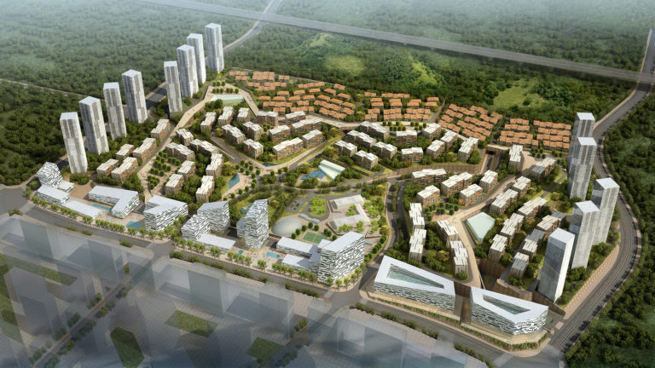
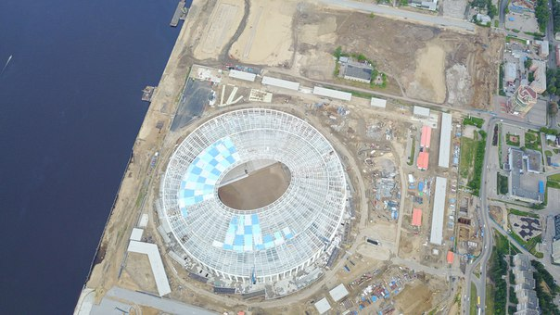
Purpose
Development of effective algorithm for building detection on satellite images based on deep learning methods

Slide 3
Algorithm requirements
Take into account the small size of objects
Be invariant to rotation
Have enough training examples
Have an ability to handle huge pictures
Cope with noise

Slide 4
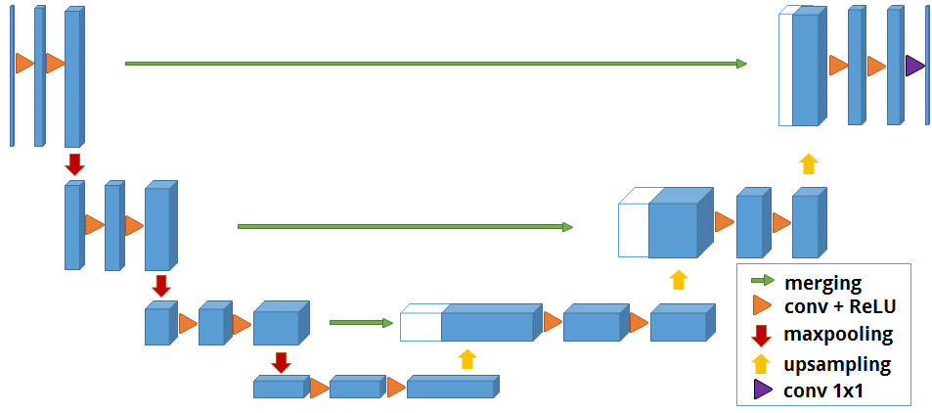
U-Net
Trainable parameters: 7.8 mil

Slide 5
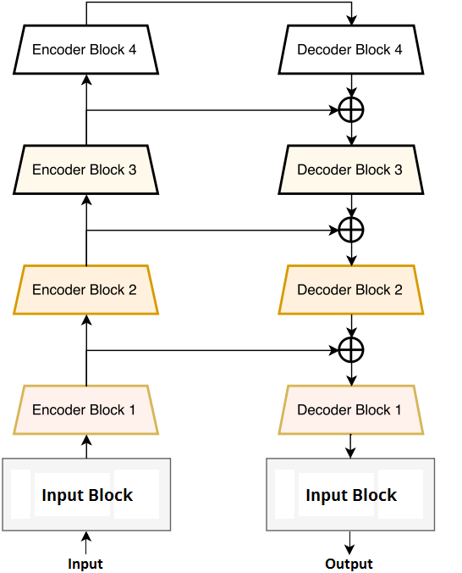
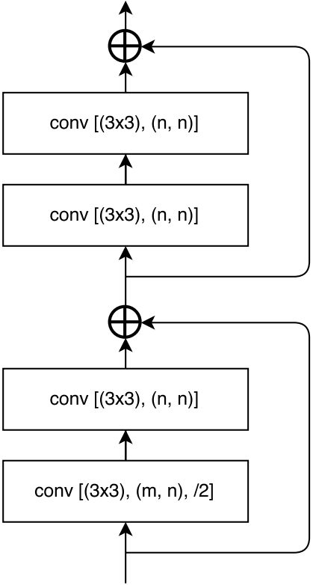
LinkNet
Trainable parameters: 17.2 mil

Slide 6
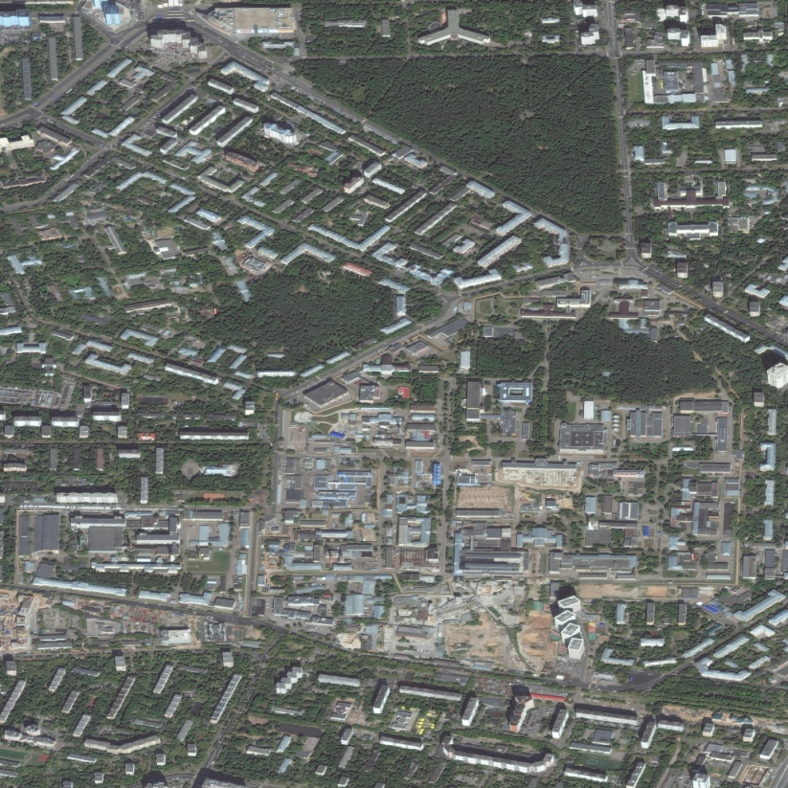
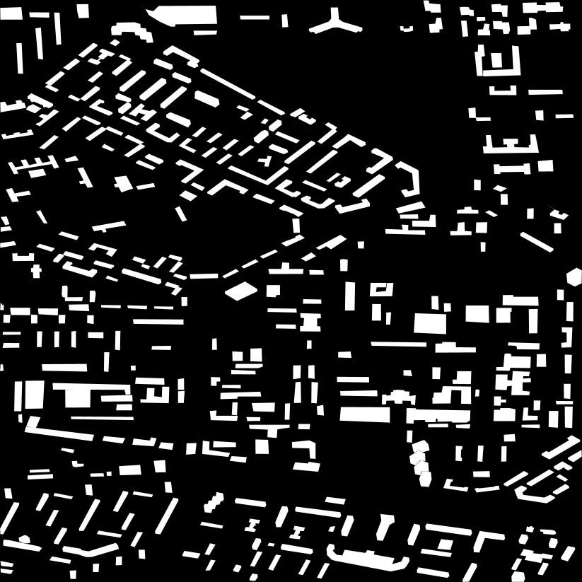
Planet database
14 samples in JPG format
Manual image markup (https://supervise.ly)
Resolution: 8192x8192 px, 0.5 m/pixel
3 Russian cities: Moscow, Yaroslavl, Rybinsk

Slide 7
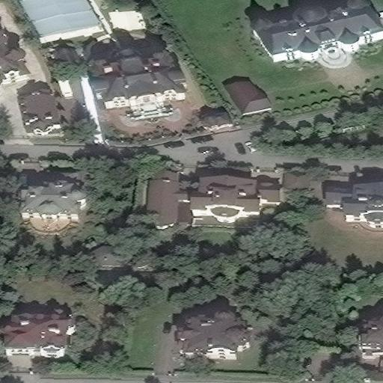
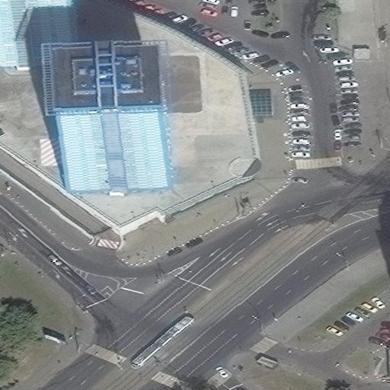
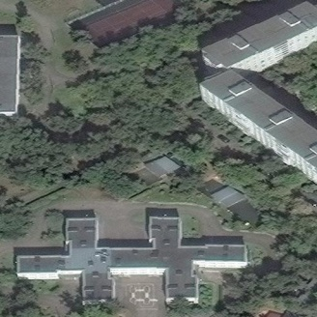
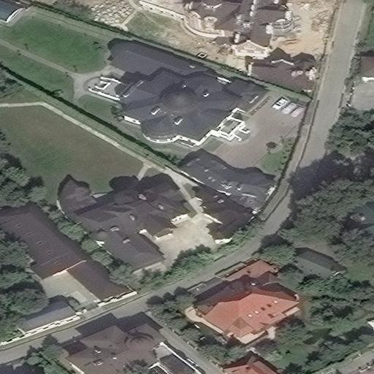
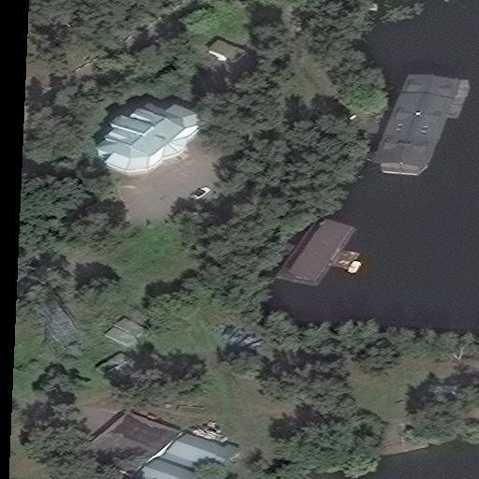
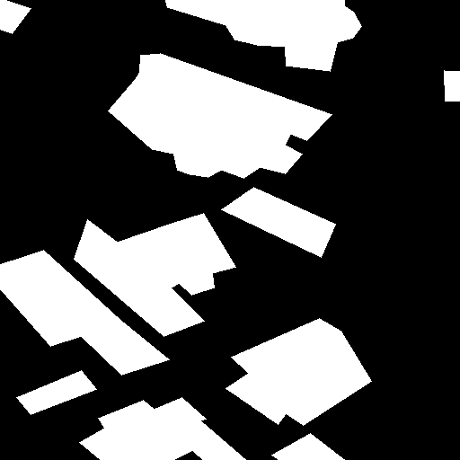




Dataset preparation
Cropped image resolution: 512x512 px
Training set: 2611 images
Test set: 653 photos

Slide 8


Training and testing
Loss function: binary cross-entropy
Optimizer: Adam
Batch size: 18 cropped samples
Epochs (E): 96
Time: 2 hours

Slide 9
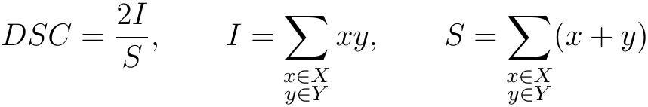
Numerical results
Model | Sorensen-Dice coefficient (DSC)
U-Net | 0.77
LinkNet | 0.72

Slide 10
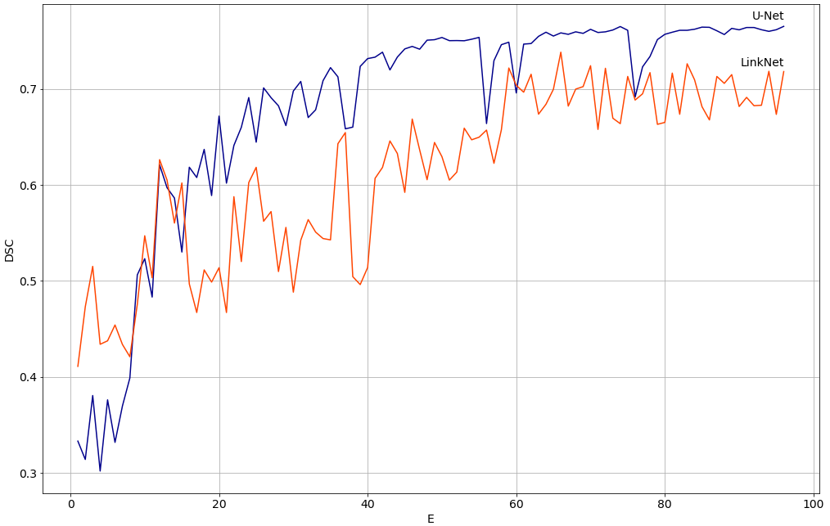
Numerical results

Slide 11
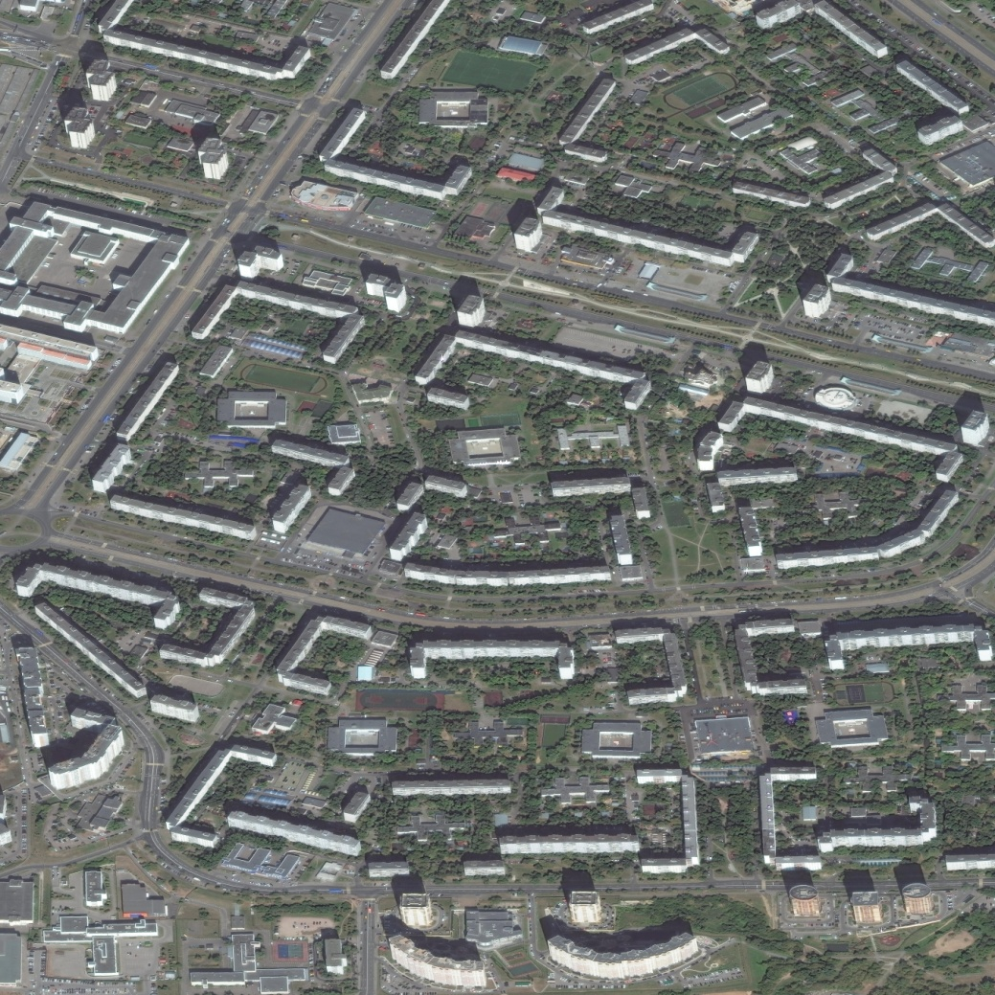
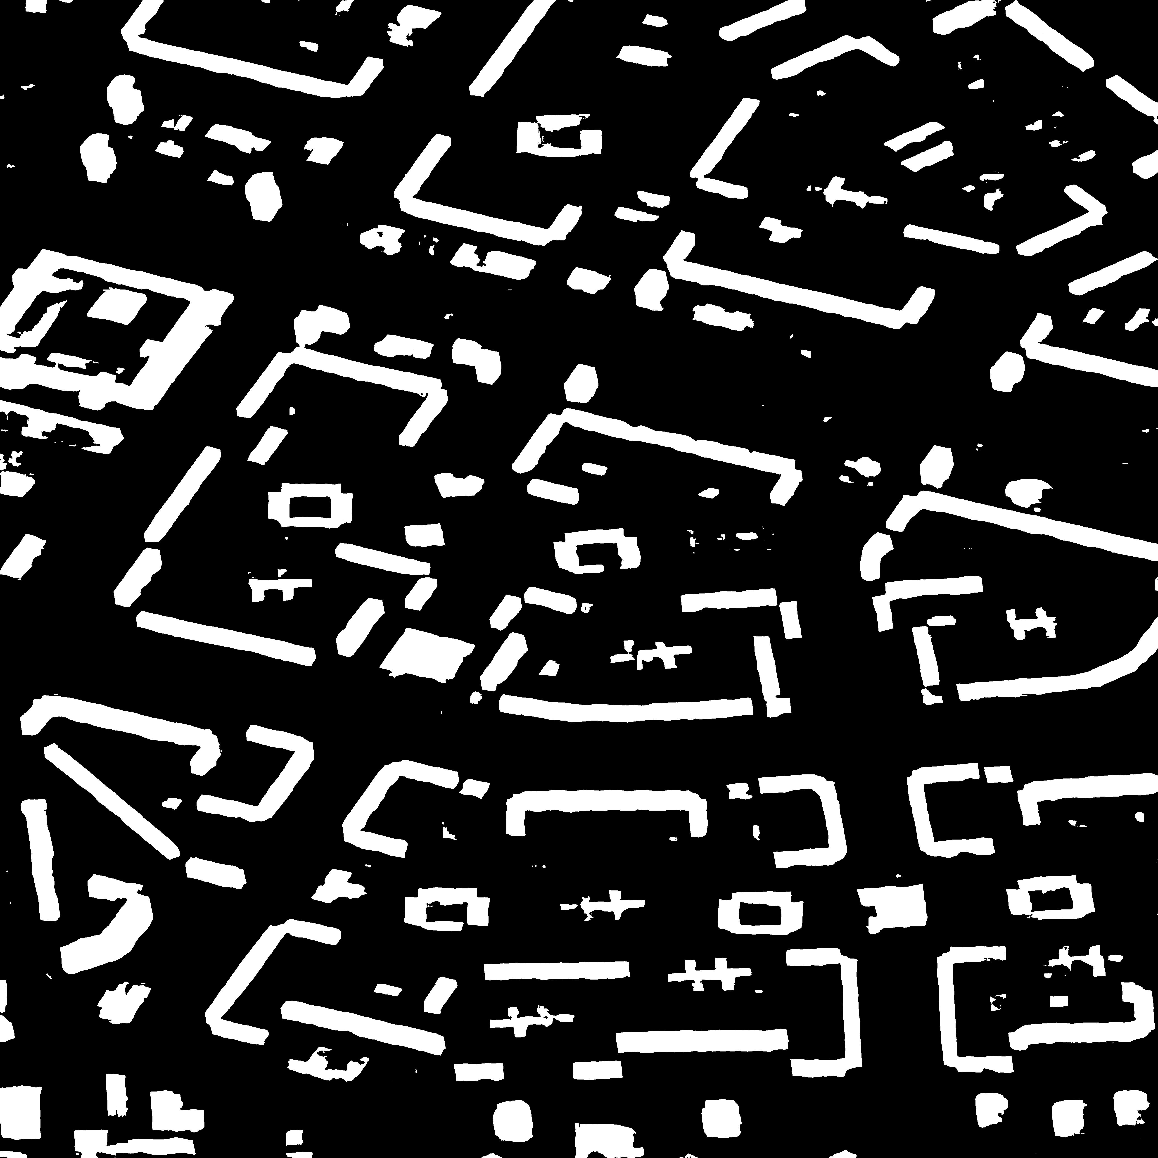
Examples of detection

Slide 12
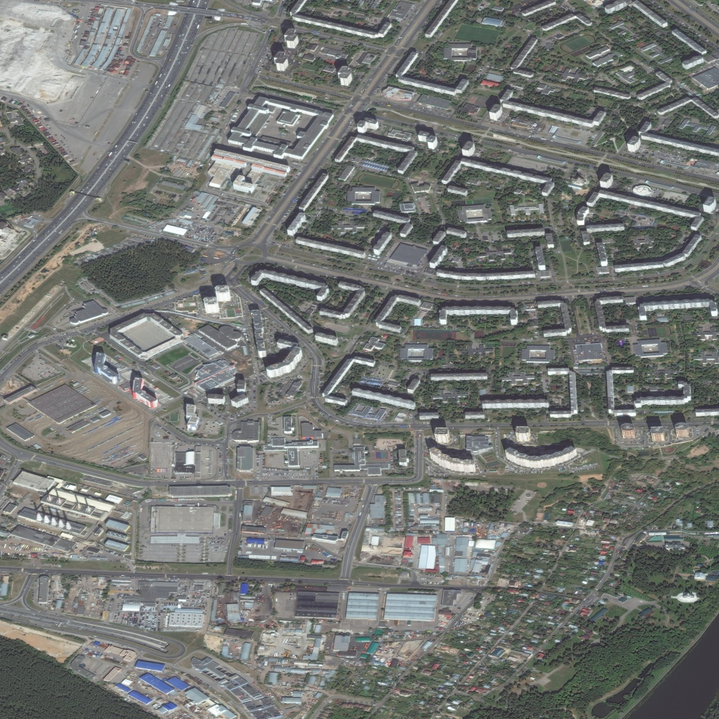
Examples of detection

Slide 13
Conclusions
CNNs can be effectively used for building detection on aerial photos
U-Net and LinkNet were developed to cope with satellite images segmentation
The training of CNNs was carried out on supercomputer NVIDIA DGX-1
The best performance was given by using U-Net

Slide 14
Future plans
Try more complicated loss functions
Detect building corners
Try mask search algorithms (Mask R-CNN, Faster-CNN)

Slide 15

Acknowledgment
The work was prepared with the financial support of the Ministry of Education of the Russian Federation as part of the research project No. 14.575.21.0167 connected with the implementation of applied scientific research id. RFMEFI57517X0167

Slide 16
The 14th International Conference on Pattern Recognition and Information Processing (PRIP’2019)
Minsk, Belarus, May 21-23, 2019
High-resolution Aerial Image Segmentation for Automated Building Detection
Leonid Ivanovsky
Anna Ostrovskaya
Vladimir Khryashchev
Anatoly Sedov

